Slide 1
Markov Decision Process project-3
Christian M. Adriano (Chris)
christian.adriano@hpi.de
Notes:
https://en.wikipedia.org/wiki/Transduction_(machine_learning)

Slide 2
Project-3 description

Slide 3
Project-3 Goals
Apply Reinforcement Learning to a realistic scenario (Self-Repair System)
Learn how to use the OpenAI Gym interface
Apply the Hidden Markov Model to incorporate partial observability in decision making
Substitute the static transition matrix for the ones that you learned in Project-2
Compare RL algorithms
Evaluation Convergence Charts produced for
Different failure patterns
Different HMM transition matrices

Slide 4
Intro to Self-Healing
Slides on Intro-Self-healing and Self-optimization with mRUBis.pptx

Slide 5
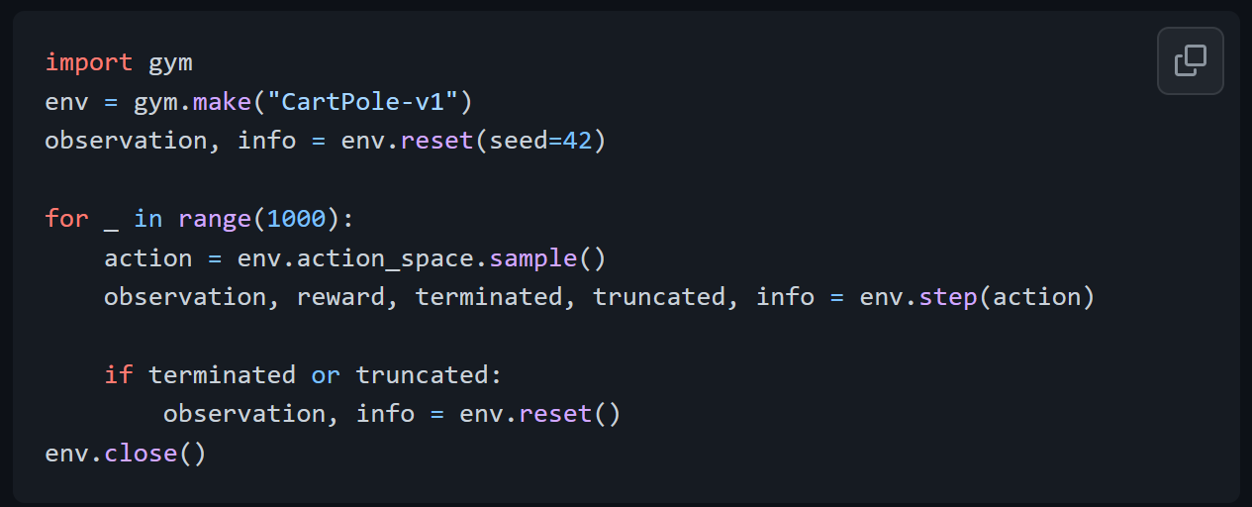
The Gym interface
https://github.com/openai/gym

Slide 6
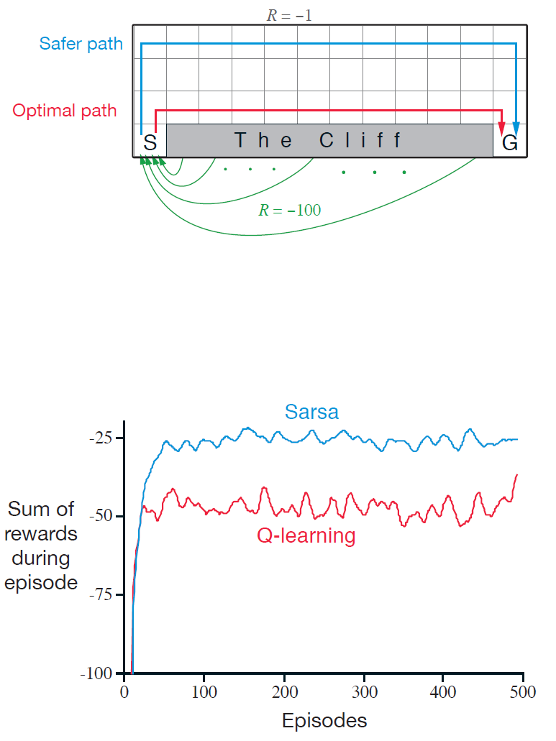
Projects Alternatives (pick one!)
Compare two tabular methods
Compare tabular Q-Learning with Deep Q-Learning
Compare DQN (Q-Learning) with Actor-Critic (Policy Optimization)
Reproduce the famous Sutton&Barton cliff maze
Gridworld example from [Sutton & Barto 2018] page 132.
Goal: is to go from S to G avoiding the Cliff.
You can reuse any implementation of the algorithms, including Stable Baselines
https://stable-baselines3.readthedocs.io/en/master/

Slide 7
Markov Decision Process Model
Apply repair (pop top of stack)
C.1
Reorder repair (swap stack items)
B.1
B.1
Terminal State
A.1
B.1
Swapped item
B.1
C.1
C.1
C.1
B.1
C.1
A.1
A.1
A.1
Final Reward = Σ Intermediate Rewards
C.1
C.1
A.1
C.1
B.1
B.1
A.1
A.1
A.1
B.1

Slide 8
Suggested questions to answer
What do you expect that would be difference in convergence (rate and optimality) between the two algorithms? Why?
Do you believe that certain failure patterns would be more difficult for the agent to learn the correct fix? Why?
What would, w.r.t. algorithm choice to improve the ability of the agent to learn a new failure pattern? Think of transfer learning.
Imagine that after deploying the agent, some adversary infects the environment with a malware with a determinist effect, e.g., shifts the distribution of certain component utilities. What could you do with respect to training to quickly adapt to this adversarial situation?

Slide 9
Main components
Environment
Environment interface (based on [1])
https://github.com/hpi-sam/rl-4-self-repair/blob/master/envs/data_handler.py
Our example:
https://github.com/hpi-sam/rl-4-self-repair/blob/master/envs/Playground_BrokenComponentsEnv.ipynb
List of failures (initial state):
https://github.com/hpi-sam/rl-4-self-repair/blob/master/envs/broken_components.py
Transition matrix to be substituted
https://github.com/hpi-sam/rl-4-self-repair/blob/master/data/transition_matrix/transition.py
Agent
Q-Learning
Sarsa
https://github.com/hpi-sam/rl-4-self-repair/blob/master/qlearning_nb.ipynb
[1] OpenAI Gym - https://gym.openai.com/

Slide 10
End

